Slide 1
Generic Programming
Rajasekaran S
Assistant Professor,
Department of Information Technology,
KGiSL Institute of Technology,
email: proffraja@gmail.com
Github:www.github.com/rajasekaranap

Slide 2
Generics Programming
Generics help us to write program that independent of data types.
A function can receive any type of argument and process.
A class can be created that supports for all data types.
Sole idea is one program for all data types.
Generics also provide compile-time type safety that allows programmers to catch invalid types at compile time

Slide 3
Generic Methods
We can write a single generic method declaration that can be called with arguments of different types.
Based on the types of the arguments passed to the generic method, the compiler handles each method call appropriately.

Slide 4
Rules to define Generic Methods
All generic method declarations have a type parameter section delimited by angle brackets (< and >) that precedes the method's return type ( < E > in the next example).
Each type parameter section contains one or more type parameters separated by commas. A type parameter, also known as a type variable, is an identifier that specifies a generic type name.
The type parameters can be used to declare the return type and act as placeholders for the types of the arguments passed to the generic method, which are known as actual type arguments.
A generic method's body is declared like that of any other method. Note that type parameters can represent only reference types, not primitive types (like int, double and char).

Slide 5
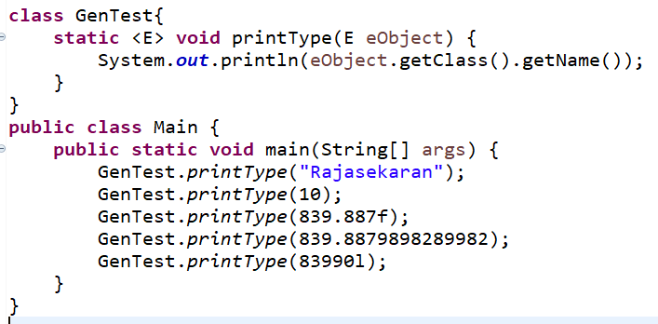
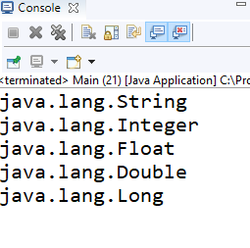
Printing Class Types

Slide 6
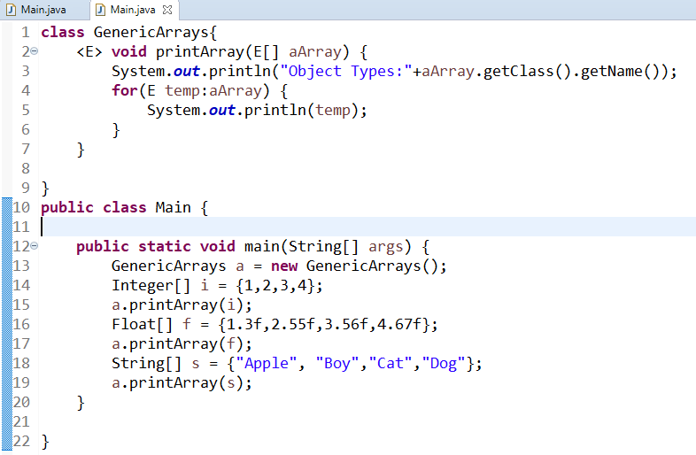
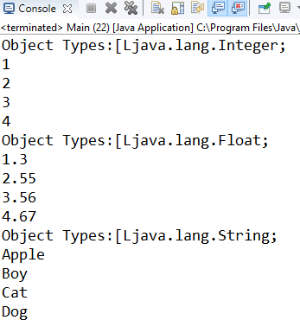
Printing Different Types of Arrays

Slide 7
Generic Classes
Class can be written as generic types.
T is used as place holder for classes.
It can receive more than one parameter when compare to generic methods.

Slide 8
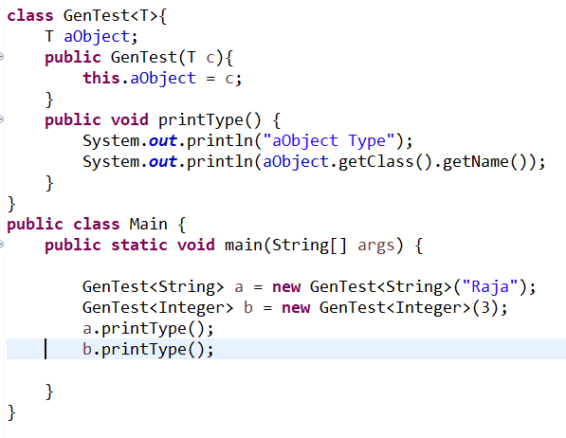
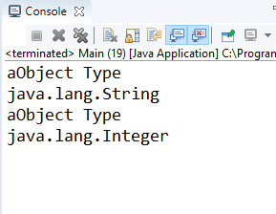
Printing Class Types

Slide 9
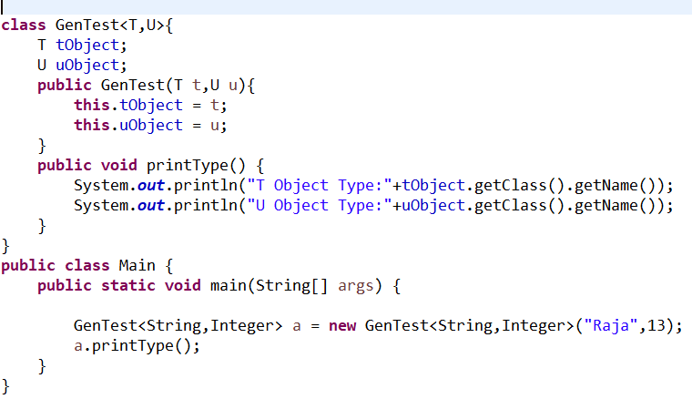
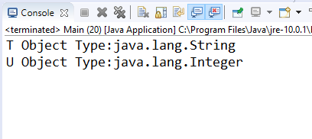
Receiving More than one types

Slide 10
Bounded Types
We can restrict the type parameter to only receive certain types.
For example if we need to perform addition of array elements then it means the array contains only numbers.
Addition doesn't make sense to string arrays.
So we can restrict the type to numbers.

Slide 11
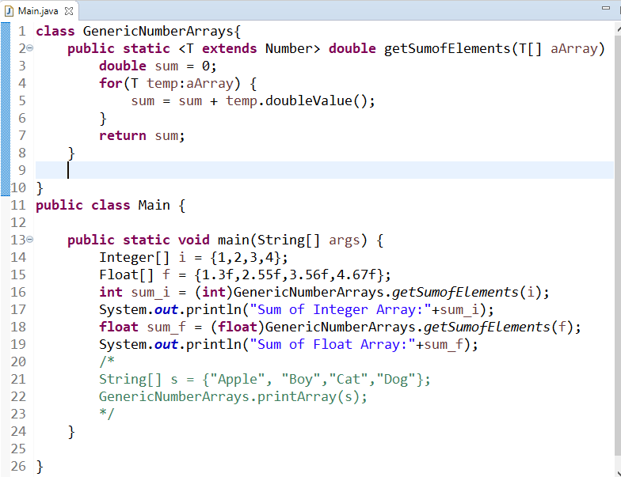
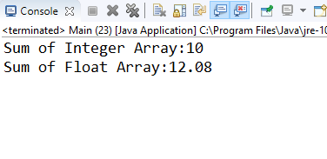
Type Restricted to Numbers

Slide 12
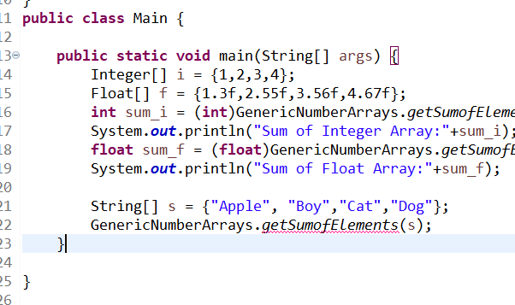
Trying the same for String
Error

Slide 13
Restrictions and Limitations
Cannot Instantiate Generic Types with Primitive Types
Cannot Create Instances of Type Parameters
Cannot Declare Static Fields Whose Types are Type Parameters
Cannot Use Casts or instanceof with Parameterized Types

Slide 14
Restrictions and Limitations
Cannot Create Arrays of Parameterized Types
Cannot Create, Catch, or Throw Objects of Parameterized Types
Cannot Overload a Method Where the Formal Parameter Types of Each Overload Erase to the Same Raw Type

Slide 15
Thank You
Rajasekaran S
Assistant Professor,
Department of Information Technology,
KGiSL Institute of Technology,
email: proffraja@gmail.com
Github:www.github.com/rajasekaranap

